Slide 1
Asteroid Photometry: 1110 Jaroslawa: Results of an International Collaboration
By: Kevin Ryan
Maurice Clark
Julian Oey
Frederick Pilcher

Slide 2
The Project
Previous observations of this asteroid, in 2011, observed a synodic period of almost exactly 4 days.
Since the period was so long international collaboration was required in order to obtain the full lightcurve.

Slide 3
The Observations
Observers:
Kevin Ryan- Lubbock, Texas
Maurice Clark- Lubbock, Texas
Julian Oey- New South Wales, Australia
Frederick Pilcher- Las Cruces, New Mexico
Several problems with weather and with the equipment limited our overall results.
A total of 23 nights of observations were obtained between January 20th and April 11th.

Slide 4
Data Analysis
All data was analyzed using MPO Canopus
After some difficulty with matching all of the data points was experienced, it was suggested that the CSS or Comparison Star Selector be utilized.

Slide 5
Data Analysis Cont.
CSS Method: Allows one to select comparison stars with the same spectral type as the Sun.
This minimizes errors caused by differential color extinction due to varying altitude.

Slide 6
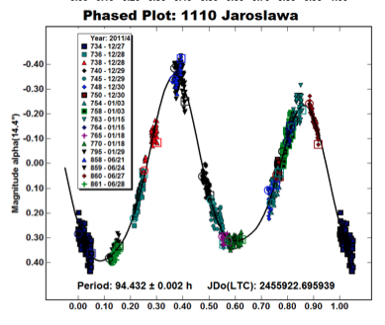
Results 2011

Slide 7
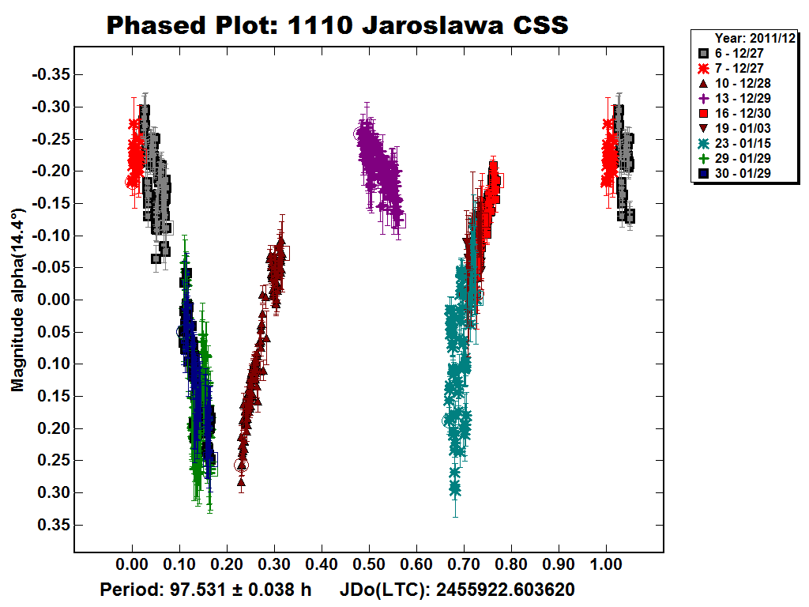
Results: 2011 CSS

Slide 8
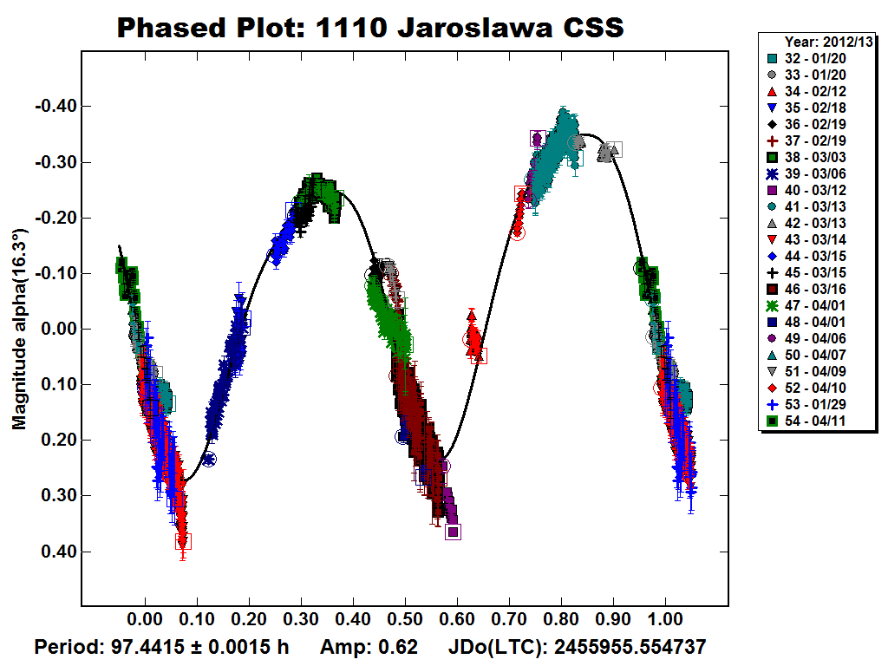
Results: 2013

Slide 9
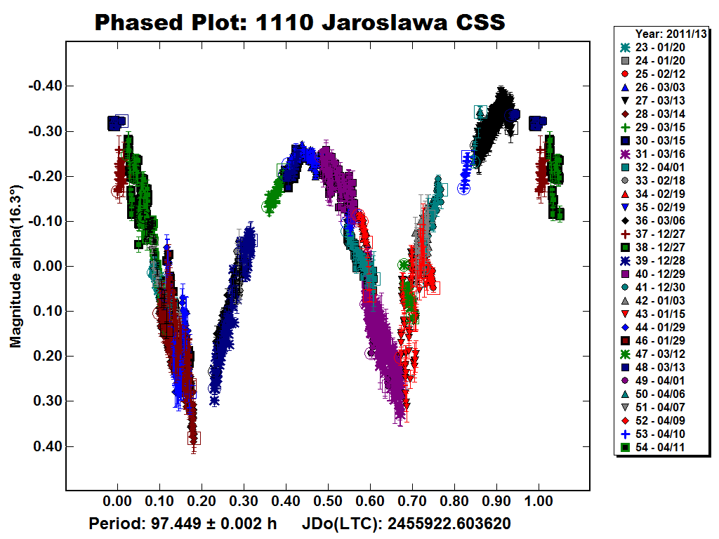
Results: 2011 and 2013 combined

Slide 10
Conclusion
The international collaboration proved to be a valuable exercise.
It was a great way to learn the intricacies of data analysis.
However we were still unable to obtain a full lightcurve for the 2013 opposition.

Slide 11
The Next Opposition
September 2014
It will be bright enough for observers with smaller telescopes
It will be located in Pisces and therefore accessible to observers in both hemispheres
We are requesting observers at various longitudes

